Slide 1


Capstone Project: Business Intelligence Solution for HCA Healthcare
Rachael Herman
Colorado State University Global
MIS480: Business Analytics and Information Systems
Professor Justin Bateh
October 9, 2022
Notes:
Hello and welcome to my final capstone project. In this presentation, I’ll be reviewing a business intelligence solution for a U.S. based organization, where a business problem is identified, researched, and analyzed using a public data set.

Slide 2
Introduction
HCA Healthcare background and rationale for choosing this organization
Data set = CMS Patient Satisfaction Survey Data (2016-2020)
BI tools = Power Query, RStudio, and Microsoft Power BI
Code and functions for statistical analysis
Interpretation of statistical results
Visualizations and interpretations
Notes:
The organization of focus for this project is HCA Healthcare. This organization puts a heavy emphasis on improving patient care, so this research focuses on publicly available patient experience survey data from CMS between 2016 and 2020.
The data analyzes overall patient satisfaction in the U.S and compares the national average for important topics like mortality rates, readmissions, and overall patient experience.
The goal is to identify areas where HCA can focus resources to gain more insight into patient experience within its own facilities.
This presentation describes the business problem, the public data set used, the business intelligence tools utilized, the code and functions performed for statistical analysis, data visualizations and interpretations, and recommendations of how HCA Healthcare can use the information.

Slide 3
HCA Healthcare Background & Rationale
HCA Healthcare, services provider, Based in Nashville, TN (Our history, n.d.)
186 hospitals and 2,000+ ambulatory sites of care (Who we are, n.d.)
Heavy focus on using data from 35 million encounters/year (Who we are, n.d.)
Uses data to develop tech and best practices that improve patient care (Wo we are, n.d.)
Healthcare background and career aspirations
Notes:
For this project, I’ve chosen to research the US-based organization, HCA Healthcare.
While they have a few locations in the UK, they are primarily in the United States, with headquarters based in Nashville, TN.
They have 186 hospitals plus more than 2000 ambulatory sites-of-care around the country.
HCA Healthcare was chosen for its size and for-profit status and because of my background in healthcare as a medical transcriptionist and then content marketer for small medical offices. Further, a HIPAA privacy and security certification offers me a rich understanding of the data in this industry.

Slide 4

Business Problem Addressed
Patient satisfaction directly related to revenue, with positive experiences linked to increased profitability (Richter & Muhlestein, 2017).
Many variables determine patient satisfaction, eg., Cleanliness, communication, and care transition.
HCA public reviews indicate areas of improvement for communication, staff friendliness, and care transitions.
Public data will help organization find where to focus internal surveys to identify areas of improvement.
Notes:
Patient satisfaction is the extent to which patients and their caregivers are happy with the care they receive.
Patient experience is directly related to revenue, with positive experiences linked to greater profitability (Richter & Muhlestein, 20017).
Survey data from CMS focuses on where patients are most and least satisfied in similar facilities to HCA. The data looks at how patients rate topics like noise, doctor communication, care transitions, and facility cleanliness.
As HCA Healthcare does not have any public data sets available, the CMS data can help the organization formulate an internal patient survey and aggregate public reviews to identify areas for improvement at its facilities.
That internal data can be compared to the national data presented here.

Slide 5

Data Set Used and Where to Access
CMS hospitals data archive includes US patient satisfaction survey data from 2016-2020 (PQDC, n.d.).
Data can be accessed and downloaded from the CMS website.
5 CSV files merged to one and had over 2 million observations and 43 variables
Data cleaned and reduced to 20 variables and 132,174
Merged data stored in Power BI, GitHub, and Google Drive
Notes:
The data set chosen for analysis came from CMS hospitals data archive and includes U.S. patient satisfaction survey data from 2016 to 2020 (PQDC, n.d.). This data is readily available from the CMS website.
The five CSV files were combined into a single, merged file, which is stored in Power BI, GitHub, and Google Drive.
The combined set included 43 variables and more than 2 million rows of data. Cleansing was performed in Power Query, removing irrelevant columns and rows with unavailable or unimportant data. For example, cells marked “not available” in patient rating were deemed unimportant and removed.
After cleansing, the data set was more workable, with 20 variables and just over 132,000 observations.

Slide 6
Tools Used
Power Query in Excel for Data Cleansing
RStudio for Statistical Analysis
Microsoft Power BI for Data Visualization
Notes:
Data cleansing was necessary for this project given the number of files and observations. There were a lot of variables that were deemed unnecessary. Therefore, the files were loaded, merged, and transformed in Power Query.
R is an open-source programming language and statistical analysis tool that offers significant insight into qualitative and quantitative data. RStudio is the IDE, or integrated development environment, for R and was used for this analysis.
Microsoft Power BI is a robust visualization tool that is good for analysis and creating dynamic dashboards. Power BI helped translate the statistical data into a visual, interactive dashboard.

Slide 7

Code and Functions
The str() function gives a good view of data types
The topic was converted to a factor using mutate(), and ratings summarized with filter(), group_by(), and summarise() functions. Ungroup() used to make sure the grouping doesn’t affect the rest of the analysis.
Scatter plot of patient ratings per topic using ggplot(), geom_point(), and theme().
The lm() function is for linear regression to identify important predictors/coefficients
The table() functions provide a contingency table to ensure there were plenty of surveys to review in proprietary facilities
Notes:
Several packages were installed in RStudio for computations and modeling. Topic needed to be converted to a factor, which was done using piping and the mutate function. The structure function gives an overarching view of the kind of data we’re working with in the set.
The variable hospital_data_summarise used the df data frame to summarize the means for ratings at proprietary facilities, separated by topic. This used a piping function, as well as the filter, group_by, and summarize functions, followed by the ungroup function so it did not affect the rest of the analysis.
A simple scatter plot to look at average patient rating was created using the ggplot, geom_point, and theme functions.
The linear regression model using the lm() function helped find significant coefficients to the patient and hospital ratings based on topics. A contingency table was created using the table() function and provided a clear look at the number of reviews (1 through 5) for each topic at proprietary facilities.

Slide 8

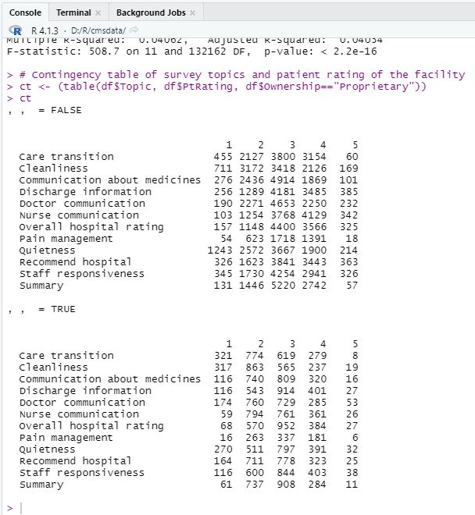
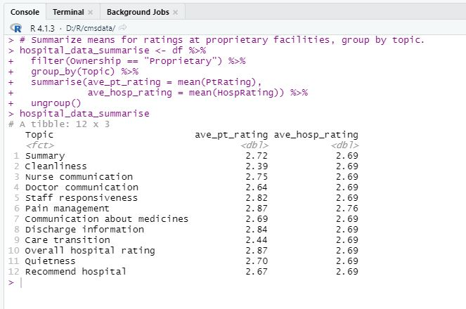
Summarized Averages and Contingency Table
Notes:
The summarized averages showed relatively uniform values for hospital ratings at proprietary hospitals over the five-year period. The median for both is 3, which is seen on the left side contingency table.
The contingency table shows the most frequent reviews are 2 to 3, seen in the bottom table of the left image, which is for proprietary facilities.
Interestingly, we can see in the top of the contingency table, which is for all other facilities combined, that patients tend to rate the topics a 3 or 4. This may be the result of more reviews.
The right image shows the average patient and hospital ratings filtered to show proprietary facilities, grouped by topic. Here, we can see the uniformity in hospital ratings per topic, except for pain management. There is some variation in patient ratings for each topic.

Slide 9
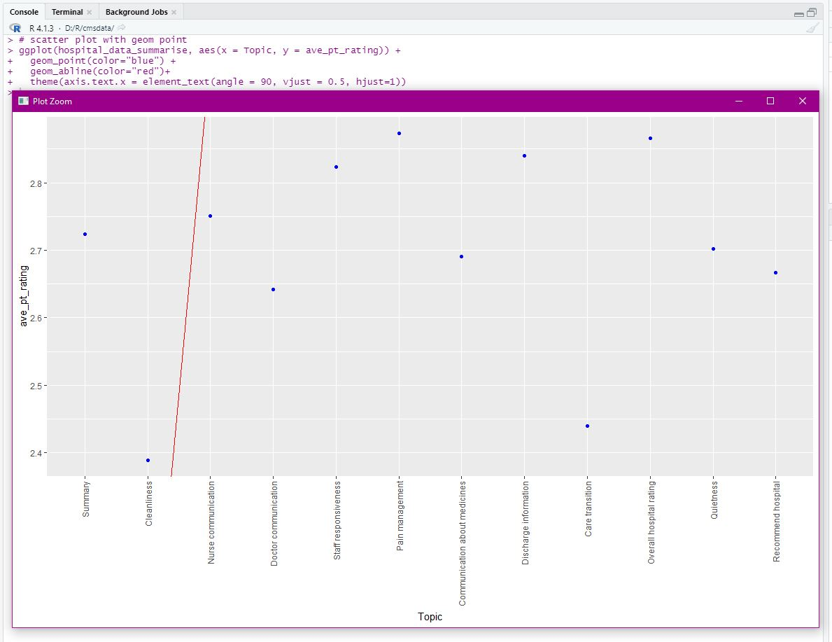
Scatter Plot of Patient Ratings by Topic
Notes:
A scatter plot is used to get a better look at the patient ratings by topic. Using geom(abline) we can see a weak scattering of ratings per topic. This is also demonstrated in the linear regression models.

Slide 10
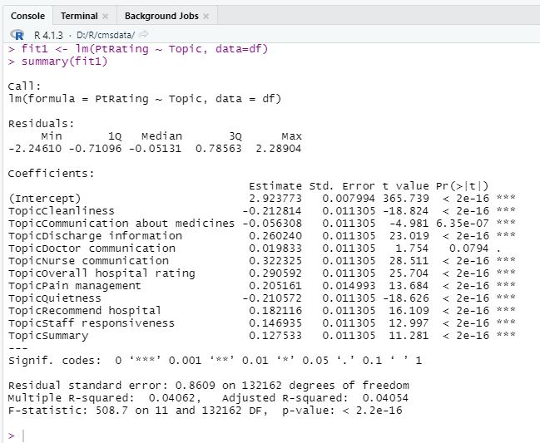
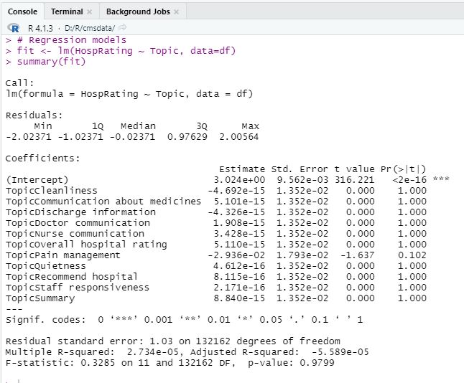
Linear Regression As Predicted by Topic
Notes:
These two regression models indicate that hospital ratings are not affected by topics, but patient ratings are. We can see this by the p values being 1 and t values being 0 in the right table, while p values are very low and t values higher in the left table.
The R-squared and adjusted R-squared values are low, indicating weak predictors (Frost, 2017). However, the higher t-values and F-statistic in the model for patient ratings indicates a good fit model with higher confidence.

Slide 11
Interpretation of Statistical Analysis
Summary statistics show the uniformity of the averages
Linear regression models indicate that topics are significant predictors of the patient ratings, but not so much for hospital ratings.
Linear regression models using all variables is extensive and shows hospital ratings are predicted more by …. And patient ratings by ….
The contingency table shows us most patients review each topic at a 3, but 2 is also a highly used rating at proprietary facilities.
Notes:
Summary statistics show relatively uniform across both patient and hospital ratings across all 5 years, so while it provides a good, overarching view of basic statistics, it’s not very helpful in what we’re trying to see.
The linear regression models, however, are more telling. They indicate that hospital ratings are not affected by the topics reviewed by patients, but the topics clearly are, as expected.
A linear regression for hospital ratings to include all 20 variables was too large of a task for RStudio, so to gain further insights into predictors for hospital ratings, one would need to clean the data further and limit the number of observations.
The contingency table gave us an idea of how many patient reviews are in each topic at proprietary facilities. The majority were between 2 and 3.
Given the uniformity and insignificant topic coefficients for overall hospital ratings — and since patients review the overall hospital in the survey topics — hospital ratings were not the center of evaluation for this analysis. Rather, the patient ratings were used as indicators of where HCA can focus attention to improve patient experience.

Slide 12
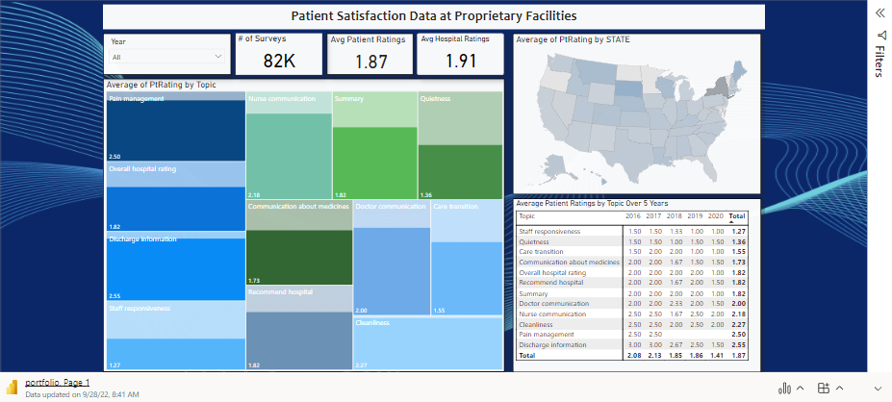
Interactive Dashboard – Power BI
Notes:
The dashboard in Power BI is completely interactive. It’s easy to use with just a few simple graphics to help users get a better understanding of the most important topics at proprietary facilities over the five-year period. Interactive dashboards help managers and users get a better measure of KPIs (Laursen and Thorlund, 2016).
Here, users can drill down by year, topic, and state.
The state map is useful for looking at HCA facilities in the lowest or highest rating states. States with the lowest ratings could be the focus for HCA surveys to see where their facilities stand against the national averages of other proprietary facilities.
To show a drill down example, we’ll start with the treemap for topics. For this example, I’ll choose Cleanliness as it’s the lowest rating topic across all five years in proprietary facilities.
This data shows the average ratings over the years, indicating that 2016 was the lowest year. Choosing 2016 shows us there are a little over 403,000 surveys, which is higher than the previous years, as we can see by clicking on those other years. This signals a serious concern for cleanliness at facilities.
The data also shows which states have the highest and lowest ratings, with the lowest ratings being the light blue-gray and highest being the dark blue. One can simply hover over the map areas to see state abbreviation and average rating. In this case Nevada has the lowest cleanliness rating in 2016 at 1.43.
Clearing the drill down, we go back to the main dashboard settings.
I’ll show another drill down example using the map to demonstrate this functionality. No other options preselected. So, across all 5 years in proprietary facilities, the lowest rating states were New York and Maryland for overall average patient ratings. New York has the lowest at 1.87, and after sorting the totals, it looks like the lowest rated topics are staff responsiveness, quietness, and care transition.
The tree map shows us how this data compares to the total in the overall set.

Slide 13
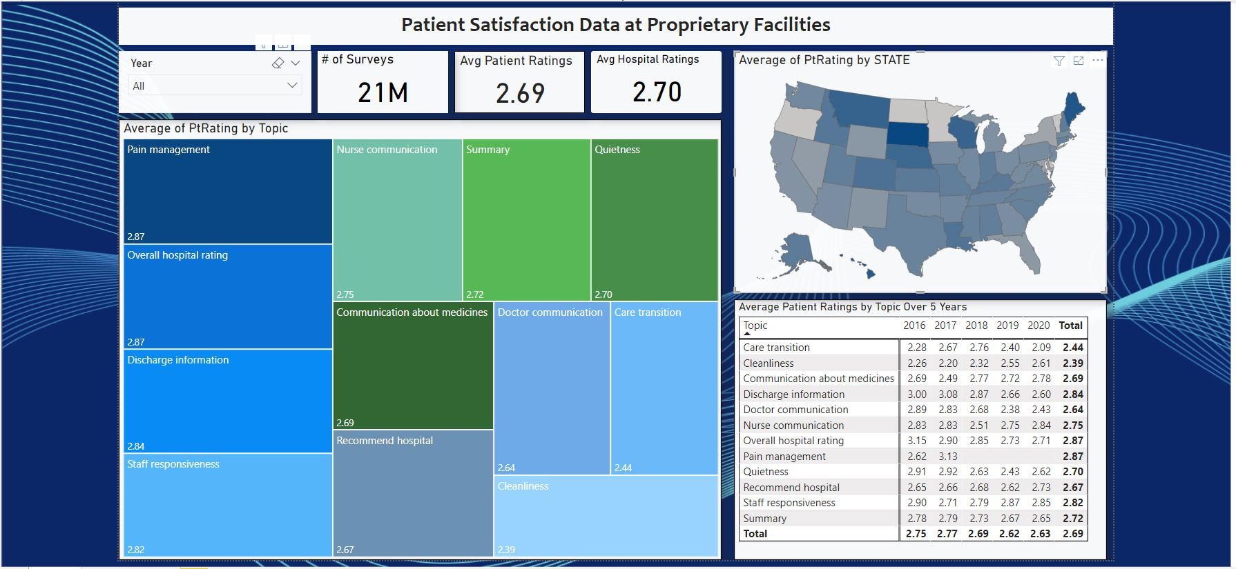
Data Visualization Interpretations and Recommendations
Patient ratings show averages in the 2 to 3 range for all topics.
States indicate where patients are most and least satisfied.
HCA Healthcare can use this BI solution to develop an internal survey focusing on topics where patients are rating the lowest scores in states where HCA has locations.
HCA can aggregate public review data for facilities in specific regions where they survey and find areas of improvement.
Notes:
A lot of interesting information can be gleaned form this data, especially with the drill-down abilities in the dashboard.
I focused on patient ratings for topics across 5 years of surveys and included the states to dig a little deeper into the data. This is especially important for a nationwide organization that has locations spread across the country.
HCA can use this information to create their own internal survey targeting specific topics in the lowest-rating states where they have locations. Then, they can aggregate public review data for those regional facilities and compare them to internal and national survey data for greater insights into patient satisfaction and experience.

Slide 14


Challenges and Limitations
National survey data was a large set and required cleaning
Determining which tools would best suit the project was difficult. Learning curves were considered.
The set is too large to run a linear regression model on ratings using all variables
Data does not include ambulatory facilities, hospital size, or revenue information
Notes:
There were a few challenges in the project and limitations in the data that should be recognized.
First, the biggest challenge was in merging and cleaning the data. This took the majority of time, as it was difficult to clean the data when I didn’t have a clear view of what would be needed. However, getting it down to 20 variables from 43 and about 132,000 observations from over 2 million was a good result that led to reliable analysis.
Another challenge was in deciding which BI tools to use. In one of the milestones, I had chosen Tableau for visualization and SAS for statistical analysis, but these programs proved very difficult to learn with too steep of a curve. Microsoft Power BI was used in place of Tableau and was much easier to use. It also offered an interactive option for this presentation, which I found compelling.
RStudio was used in place of SAS as this is the software we have been using most throughout the program and was much easier to use for statistical analysis.
Some limitations are that the data set did not include the size of the hospitals, ambulatory care facilities, or revenue information to compare to HCA’s business profile. However, given the goal was to identify topics of concern to patients around the country, this data proved useful.
Another limitation was in running linear regressions. It was difficult to determine significant predictors or coefficients for hospital ratings because of the size of the data; however, given the ratings were not influenced by topic, I felt it was safe to remove them from most of the analysis and interpretation, especially as I was primarily focused on patient ratings regarding the hospitals. Also, one of the survey topics was “overall hospital rating,” so I was comfortable excluding the hospital ratings variable from most of this analysis.

Slide 15
Summary
HCA Healthcare is a large U.S. based organization with hundreds of hospitals and thousands of ambulatory care facilities nationwide.
They focus heavily on improving patient experience and care by analyzing data from millions of visits.
The BI solution presented here offers insight into patient ratings for specific topics at similar hospitals around the country.
HCA can use this data to develop internal surveys for low-rating topics in low-rating states where they have locations and combine this data with aggregated public review data for those facilities to gain deeper insights and find areas for improvement.
Notes:
HCA Healthcare is a large U.S. based organization with hundreds of hospitals and thousands of ambulatory facilities around the country. They focus a lot of their time on evaluating data to improve patient experience and develop new technologies for best practices and patient care.
Their business intelligence solution presented here centers around patient experience through survey data of nationwide proprietary (for-profit) facilities. The patient’s ratings on specific topics are critical to understanding where facilities should focus its resources for improvement.
The topics HCA should survey should be heavily focused on cleanliness, doctor communication, and care transitions, but that doesn’t mean they should ignore the other topics. HCA Healthcare can tailor internal surveys and target states with the lowest ratings and compare that data to internal reviews to get the best insights.

Slide 16

Thank You for the Experience
Notes:
This project has been both challenging and rewarding, as I learned a great deal not only about patient satisfaction, but about the business intelligence tools.
Thanks for your time and guidance throughout this term. Please let me know if there are any questions regarding this presentation or the related essay.

Slide 17
References
Frost, J. (2017, April 16). How to interpret R-squared in regression analysis. Statistics by Jim. Retrieved September 27, 2022, from https://statisticsbyjim.com/regression/interpret-r-squared-regression/
Laursen, G.H. N., & Thorlund, J. (2016). Business analytics for managers: Taking business intelligence beyond reporting (2nd ed.). Wiley Professional Development (P&T). https://mbsdirect.vitalsource.com/books/9781119302537
Our history. (n.d.). HCA Healthcare. Retrieved September 17, 2022, from https://hcahealthcare.com/about/our-history.dot
PQDC. (n.d.). Retrieved September 8, 2022, from https://data.cms.gov/provider-data/archived-data/hospitals
Richter, J.P. & Muhlestein, D.B. (2017). Patient experience and hospital profitability: Is there a link? Health Care Management Review, 42(3), 247-257. doi: 10.1097/HMR.0000000000000105
Who we are. (n.d.) HCA Healthcare. https://hcahealthcare.com/about

